Slide 1

ATM Interface
Group 11

Slide 2
Group
2020ICTS111

Slide 3
ATM (Automated Teller Machine)
Need of ATM
Benefits
Safe
Easy
Time saving

Slide 4
We can withdrawal cash in 3 ways in ATM
Insert card
Mobile cash withdrawal
Cardless cash

Slide 5
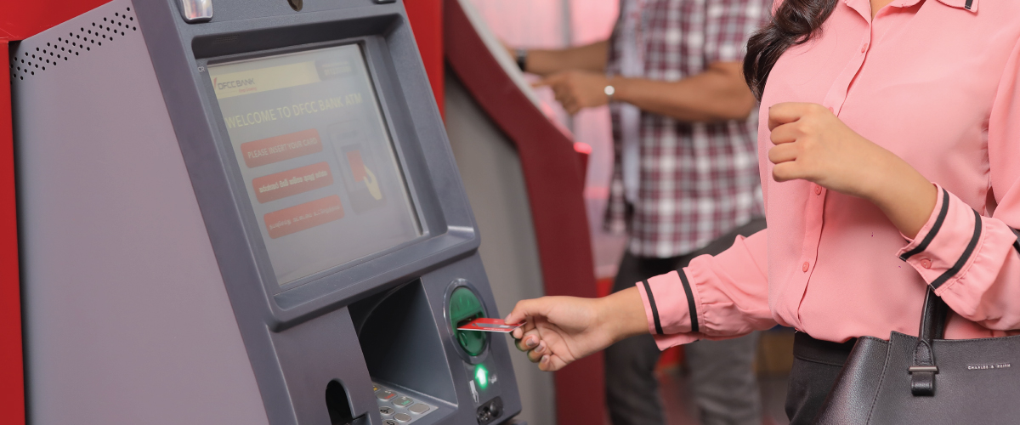
Insert card
Insert card
Language
Pin
Description
close

Slide 6
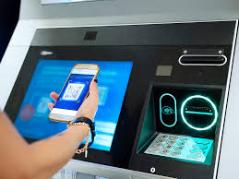
Mobile cash withdrawal
Language
Enter NIC number
Enter pin number
Verify your QR code
Take your cash

Slide 7
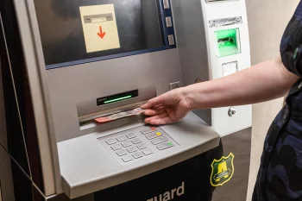
Cardless cash
Language
Enter NIC number
Enter pin number
Take your cash

Slide 8
Our project interface

Slide 9

Vote Of thanks

